Slide 1
Partial Solution of 3 x N Chomp boards in the form of (2, H, 2)

Slide 2
Summer research project
Summer 2020
With Dr. B
Combinatorial Games, specifically chomp

Slide 3
What is a Combinatorial Game

Slide 4
What makes a CG
Deterministic, no randomness
Perfect Information, nothing is hidden
Two types:
Finite, the game will end, you can't loop
Infinite, the game may not end, you can create loops

Slide 5
Chomp
Played on a board like a chocolate bar where the lower left piece is poisoned
You don’t want to eat the poison, unless you’ve built up a resistance to iocane powder
Alternating turns where you choose a piece and break off all pieces above and to the right of it

Slide 6
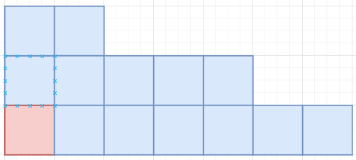
Board Types
Prescriptive: 2 x N, N x N
Pictographic: just a picture
Long form: truncated, lists columns by height
{3, 3, 2, 2, 2, 1, 1}
Short Form: truncated, lists width of groups of column heights
[2, 3, 2]

Slide 7

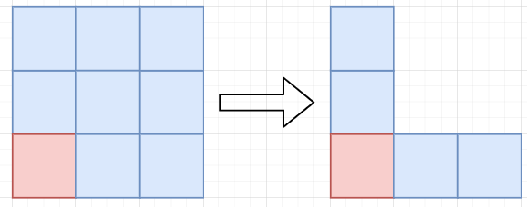
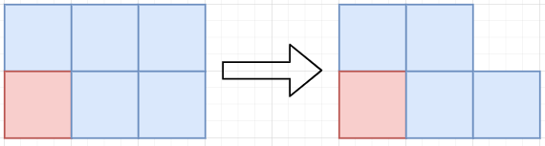
Basic Strategies
What has been solved so far:
1 x N: Go first, leave only poisoned piece
N x N: Go first, make an L, Tweedledee-Tweedledum
2 x N: Go first, take top right, Tweedledee-Tweedledum

Slide 8
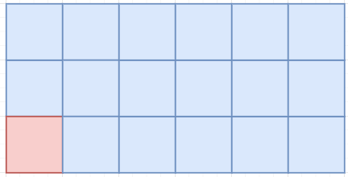
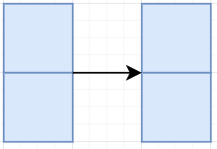
Positions
Winning and losing positions (P vs N)
Every board has a recursively defined Nim Number, but they blew up too fast
Looking at 3 x N boards
Note the arrow can be any number of blocks including zero
I call this an “H-block”
Notes:
On the table, but just keep it in mind, nnum no more than a sentence, maybe mention multiple boards?

Slide 9
What did I do

Slide 10
Data Mining with the Short Form
Wrote a Python script to iterate through all boards from a maximum size to get its position state and those of its children recursively with memoization
Work toward the base case, can exit early
Noticed a pattern in the Long Form, but it was hard to see, so I made the Short Form
{3, 3, 2, … 2, 1, 1} was always a winning position
[2, H, 2]
Saw a pattern, tried to prove it

Slide 11
Case Based Proofs
GRAPHIC GENERATING THE LIST OF THEM
(Unless I can present in person)

Slide 12
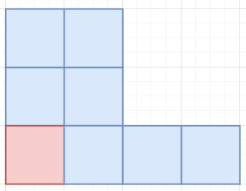
A Funky Dude
Aka [2, H, 2] when H = 0
Just Follow the normal table and treat H as zero
It works fine, but I just wanted to address the base case real fast
Notes:
Adressed in paper, but for presentation

Slide 13
1 x N

Slide 14


[0, 0, H + 2 + 2]
[0, 0, H + 4]; Op left only the bottom row
[1]; Solved 1 x N

Slide 15


[1, 0, 0]
Op broke off all 2’s, all 1’s, and one 3
[1]; Solved 1 x N

Slide 16
2 x N

Slide 17
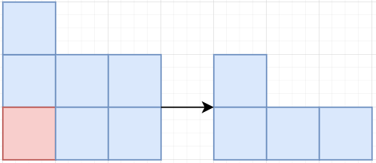
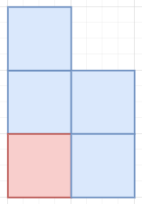
[1, H, 2]
Op removed one top block
[1, 1, 0]; Solved 2xN

Slide 18
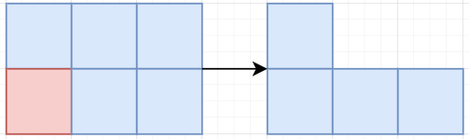
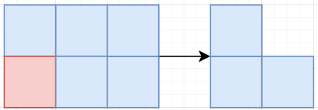
[0, H, 2]
Op cleared top row
[H, 1]; Solved 2 x N

Slide 19
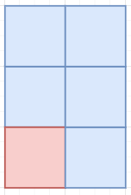
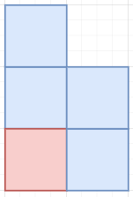
[2, 0, 0]
Op broke off all 2’s and 1’s
[1, 1, 0]; Solved 2 x N (on its side)

Slide 20
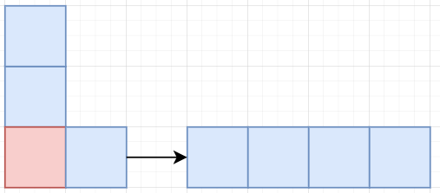
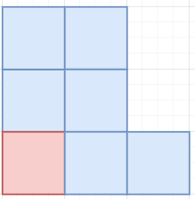
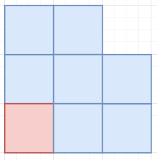
Reduces to N x N

Slide 21
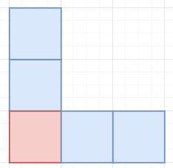
[1, 0, H + 2 + 1]
[1, 0, H + 3]; Op took all the 2’s and one of the 3’s
[1, 0, 2]; Solved N x N

Slide 22
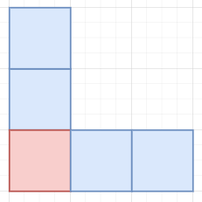
[2, 0, 1]
Op broke of the end piece and H = 0
[1, 0, 2]; Solved N x N

Slide 23
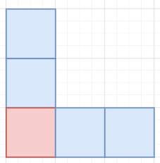
[2, 1, 0]
Op broke off both end pieces and H = 1
[1, 0, 2]; Solved N x N

Slide 24
[2, H, 2]

Slide 25
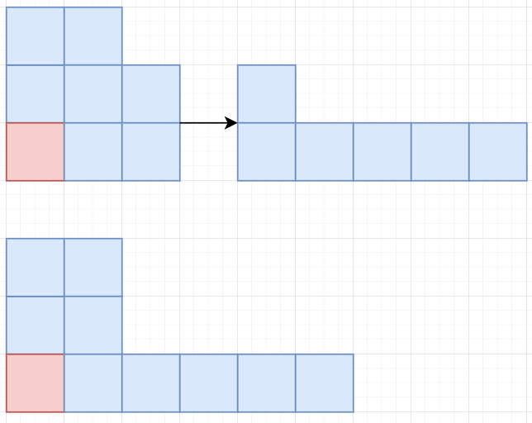
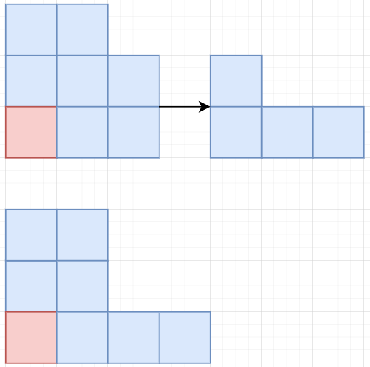
[2, H – n, 2 + n]
Op removed some/all of the 2’s
[2, H – n, 2]; Maintain [2, H, 2] form
There’s that
funky dude

Slide 26
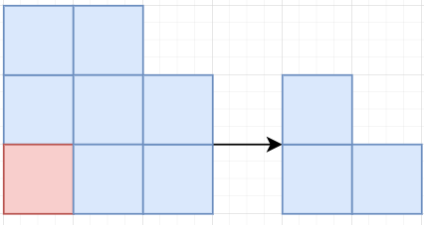
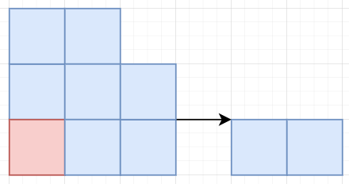
[2, H, 1] s.t. H >= 1
Op broke of the end piece
[2, H - 1, 2]; Maintain [2, H, 2] form

Slide 27
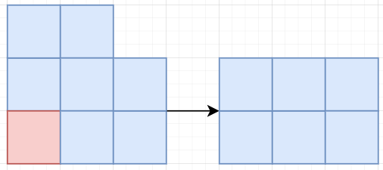
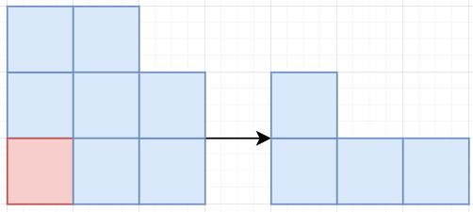
[2, H, 0] s.t. H >= 2
Op broke off both end pieces
[2, H – 2, 2]; Maintain [2, H, 2] form

Slide 28
Summary and Current Problems
As far as I can tell, no one else used the truncated forms before
Partial solution and stable boards
Not very elegant, cases may reduce
Can't reach in one move from $3$ x $N$, but it is stable

